Slide 1
MIS3690 Web Technologies
Babson College
TOIM Division

Slide 2
agenda
Introduction to the course, syllabus and deliverables
Term Project – mentioned
Software – Visual Studio Code
Architecture of the web
HTML 5 – Introduction
Your first web page!
More HTML

Slide 3
Syllabus
Instructor: Zhi Li ( 李直 )
Office: Babson Hall 216D
E-mail: zli@babson.edu
Phone: (781)239-5915
Office Hours: Wednesday 3:00PM – 4:30PM or by Appointment (via Slack or email)

Slide 4
syllabus
Course Objectives
Prerequisites and Textbooks
Software
Term Project
Personal Website for the Course
Graded Homework
In-Class Exercises
Midterm Exam
Grading
Course Policies

Slide 5
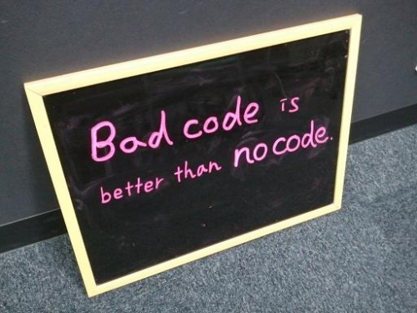
How to Learn web technologies?

Slide 6


Slide 7

Google is your (second) best teacher!

Slide 8
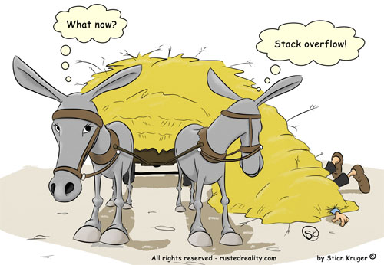
or Stackoverflow.com…

Slide 9
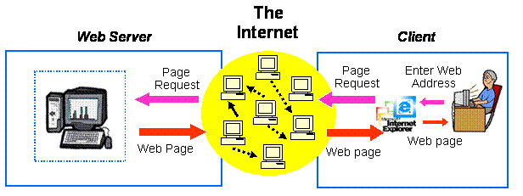
Web Architecture Overview
A Client is a machine where users can submit requests to other computers on the network (Servers on the Internet or on the local network).
A Client can be any device, such as your PC, Mac, iPhone, Android or any Smartphone.
A Server is a computer that can accept requests from clients and process a response or contact other servers
There are many kinds of servers: File Servers, Print Servers, Mail Servers, Database Servers, Web Servers….

Slide 10




Web Software Components
The Client Browser
Internet Explorer, Firefox, Safari, Chrome…
The Web Server
Apache, Microsoft IIS, nginx…

Slide 11
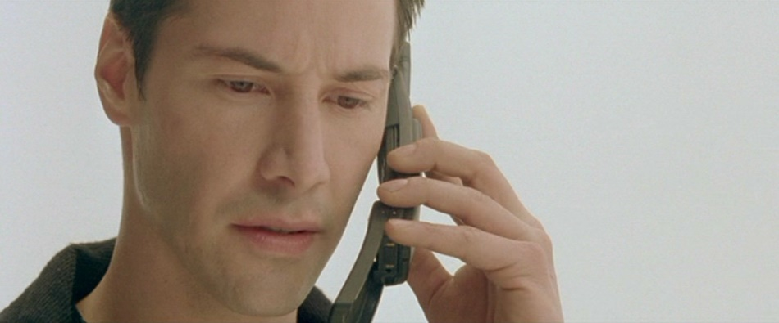
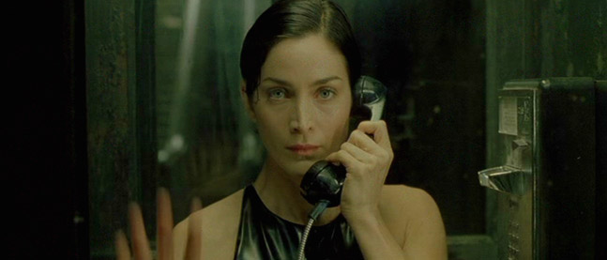
How Do The Browser and Server Really Talk?

Slide 12
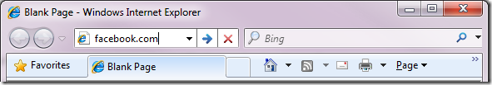

What really happens when you navigate to a URL?
You type an URL (Uniform Resource Locator, e.g., www.facebook.com) into the browser or click on a link.
Either way, the browser sends a request to the IP address specified in the URL.
The request goes to the local Server (within the company, your service provider (ISP), or the Internet).
A translator, DNS (Domain Name Service/System), translates the URL to an IP Address.

Slide 13
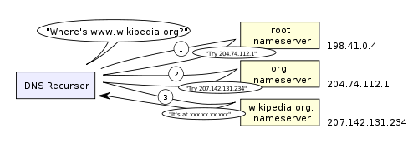
What really happens when you navigate to a URL? (cont.)
The Server determines that the address (in this case, Facebook) is outside somewhere and forwards the request to the Internet – together with the return address (your computer or client)
The Internet has a number of machines (computers) called Routers. The router, routes the request to its destination. It may go through several routers before it gets to its destination (in this case, Facebook’s Web Server).
Try to type tracert www.facebook.com in Command Prompt in your laptop and see what happens.

Slide 14



What really happens when you navigate to a URL? (cont.)
The browser sends a HTTP request to the web server.
Facebook’s server then tries to locate the specific page (specified in the URL) that your requested. Sometimes this is the home page – it could also be some specific page within Facebook’s web site.
The resource (the requested page) is then sent back. It goes through several routers on the Internet and eventually gets to the local server (in this case, Babson’s Web Server).

Slide 15
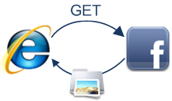
What really happens when you navigate to a URL? (cont.)
This server determines the IP Address to which the resource must be sent (the IP address of your computer).
Your browser receives the resource. The resource is coded in HTML. The browser interprets the HTML.
The browser also determines if additional resources are needed to display the page (e.g., images, multi-media, etc.) and sends additional requests for each resource needed.
Once the browser has all the resources, it interprets the HTML-coded resource and displays the page on your client computer.

Slide 16
The Web is Stateless
Web servers have no concept of a session or ongoing conversation
Once the server responds the conversation ends
We will learn some tricks to create long conversations and multi-step transactions when we learn JavaScript

Slide 17
Introducing HTML(5)

Slide 18
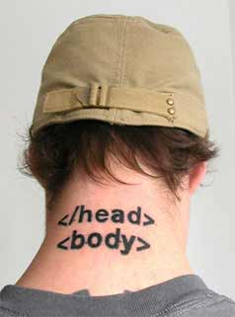
Introducing HTML
Stands for Hyper Text Markup Language
Hyper Text = the content of a web page
Markup = tags used to define how content is to be displayed
Language = syntax and vocabulary associated with marking-up.

Slide 19
Standard HTML5 Template
<!DOCTYPE html >
<html>
<head>
<meta charset="UTF-8">
<title>Page title goes here</title>
<style type="text/css">
/* Your styles go here */
</style>
<script type="text/javascript">
/* Your JavaScript goes here */
</script>
</head>
<body>
<!-- Your HTML goes here -->
</body>
</html>
<html> and </html> tell the browser where the page begins and where it ends
<head> and </head> tags define where the meta information starts and ends
<title> and </title> tells the browser what to display on the top of the page. This is required.
<style></style> and the <script></script> tags are optional. Use these in the future classes.
<body> and </body> tell the browser where the content of the page start and end.

Slide 20
Everything in HTML is defined using <tags>
<h1> Welcome to MIS 3690 </h1>
<p> This is the first paragraph that is the least bit interesting </p>
<p> This is the second paragraph that is even less interesting than the first. It is longer than the first paragraph. It also shows how the paragraph is formatted on the page. </p>

Slide 21
More simple tags – part 1
<h1> Big Text </h1>
<h2> Relatively smaller text </h2>
<h3> Even smaller text </h3>
<h4> Well, you </h4>
<h5> get the </h5>
<h6> picture </h6>
Most tags come in pairs – a opening tag and a closing tag.
Tags are enclosed in tag markers (the < and >)
Closing tags include a forward slash (/)

Slide 22
Simple tags – part 2
<i> and </i> - italicize the content
<b> and </b> - make the content bold
<u> and </u> - underline content
<hr/> - horizontal rule
Note: does not come in pairs – single tag
Note: Cannot be placed inside a paragraph (syntax of the language)
<br/> - provides a line break

Slide 23
More tags…. (what else…)
<div> and </div> - helps divide a page into sections for formatting
<span> and </span> - helps format multiple occurrences of a specific word or phrase the same way
Will use more of these when dealing with formatting and CSS
Comments
<!- - Your comment goes here - - >
For use by the web designer (you)
Will not be displayed

Slide 24
Nesting Tags
Some tags may be nested.
Some tags should not be nested.
We will learn more about “nesting” as we go through the course.
<p> This is a <i> good </i> example of how to do nesting </p>
<p><i> Bad idea </p></i>
<p> This is a really bad <hr/> example of nesting </p>

Slide 25
Special Characters in HTML
For HTML5, the default character encoding is UTF-8.
This has not always been the case. The character encoding for the early web was ASCII.
Reserved characters in HTML must be replaced with character entities.
For example, if you use the less than (<) or greater than (>) signs in your text, the browser might mix them with tags.
To use “special” characters we need additional codes. For example:
> (greater than) is done using &gt;
< (less than) is done using &lt;
& (ampersand) is done using &amp;
“ (quotation) is done using &quot;
Reference
https://www.w3schools.com/html/html_entities.asp

Slide 26
In class 01 – Creating your first web page
Download the template.
Save it.
Open the template file using VS Code (you can right-click and choose which the software to open the file with)
Add a title for the page, say, “Web Technologies – ”.
This is in the <head> section of the template.
Save the file as “CS01-InClass.htm” under folder ‘WebTech/classwork’

Slide 27
In class 01 – Adding Content
Add a heading to the page “All About ME” (replace ME with your name)
Add a paragraph on why you chose Babson and/or about what you want to be when you graduate.
Add a paragraph on your favorite sport (anything but poker).
Place a horizontal rule between the title and the first paragraph and another one at the end of the second paragraph.

Slide 28
In class 01 – Finally…….
Save the file (remember you called it “CS01-InClass.htm”)
Go to windows explorer, right click on the file and open it with Chrome or Firefox or Internet Explorer.
There is your first web page!!!!!!
Don’t forget to commit and push in GitHub Desktop.

